Slide 1
BIONIC VS SNAPDRAGON
Abhijit Gawai
Shyam Kawale
Himanshu Pande
Nishant Bhat
Bhargav Pawar

Slide 2
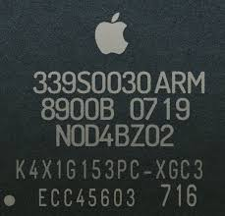
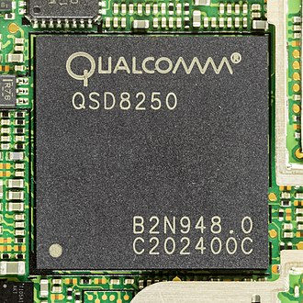
EARLY PRODUCTS
BIONIC
Apple introduced its first system on a chip APL0098 on June 29,2007 at the launch of the iPhone. It included a 412 MHz single- core ARM11 cpu.It was manufactured by Samsung on a 90 nm process.
SNAPDRAGON
The first Snapdragon processor was QSD8250 launched in November,2007.It was the first GHz mobile processor.Most smartphones at that time were using 500 MHz processors.It supported 720p resolution,3D graphics and 12 mp camera.

Slide 3
INTRODUCTION OF 64- BIT
BIONIC
On September 10,2013 apple launched APPLE A7 which was the first 64 bit POP SoC.It was introduced in iPhone 5S.It was twice as fast and had upto twice the graphic power compared to it’s predecessor APPLE A6.It’s CPU was called cyclone.It was also manufactured by Samsung on high-k metal gate 28 nm process.
SNAPDRAGON
This forced Qualcomm to rush out a competing 64 bit solution, despite the capable performance of the Snapdragon 800/801 since they were only 32 bit.The first 64 bit Soc, the Snapdragon 808 and 810 and suffered from overheating problems and throttling.

Slide 4
CUSTOM 64- BIT ERA
BIONIC
A8 is a 64 bit POP Sop manufactured by TSMC ,which replaced Samsung as the manufacturer of Apple’s mobile device processor.It was introduced on Sept 9,2014 in iPhone 6 and 6 Plus.
The APPLE A11 BIONIC was introduced in iPhone 8,iPhone 8 plus and iPhone X on sept12,2017.It has two high performance cores which are 25% faster than A10 fusion and four efficiency cores which are 75% faster than that of A10.
Latest bionic processor is APPLE A13 BIONIC(64 BIT ARM based Soc) which was first appeared in the iPhone 11,11Pro and 11 Pro Max which were introduced on Sept 19,2019.
SNAPDRAGON
After,Qualcomm’s first attempt at 64 bit system on a chip ,they created a new in house architecture,that in later models showed better thermal performance.In early 2016 they launched SNAPDRAGON 820,an ARM 64 bit quad core processor.
They also released the Qualcomm Snapdragon Neural processing engine SDK.
In December 2019, Qualcomm announced that SNAPDRAGON 865 and 765 will succeed the Snapdragon 855/855+ and Snapdragon 730/730G respectively.

Slide 5
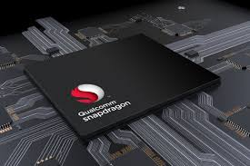
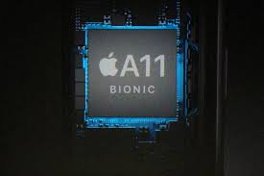
Why BIONICS are faster than SNAPDRAGON?
Cache memory
Programming language used
Garbage collection

Slide 6
CACHE COMPARISON
The Apple A7 and the A8 had 1MB L2 caches and 4MB L3 caches (5MB total)
The A9 and the A10 had a 3MB L2 cache and 4MB L3 cache (7MB total)
A11 has 8MB of L2 cache and no L3 cache (8MB total)
Whereas Snapdragon 835 has 3MB of L2 cache and no L3 cache (3MB total)

Slide 7
DIFFERENCE IN LANGUAGE
iOS apps are mostly AOT-(Ahead Of Time) compiled code (typically written in ObjC, Swift or C++) which targets the native CPU(bionic chipset).
Android apps are mostly JIT-( Just In Time) compiled code (typically written in Java or Kotlin) which targets the Java VM(Virtual Machine).
The two have different performance characteristics; generally speaking, native code is faster especially at first execution, whereas JIT code can in some cases be faster when well-optimized against the current situation, but is typically slower.

Slide 8
GARBAGE COLLECTION IN SNAPDRAGON
Memory released by apps you close has to be recycled back to the device via a process known as Garbage Collection (GC).
Unused memory (otherwise called Garbage) has to be cleaned and recycled to the system (via GC) so it can be used by other apps.
Garbage collection is super effective for the smooth running of Android device but the problem is that the process itself needs sufficient amount of RAM.
If the required amount of memory needed for GC isn’t available, processes slow down.

Slide 9
GARBAGE COLLECTION IN BIONICS
They do not undergo garbage collection to recycle used memory back to the system.
Due to the way bionic chipsets are built, the way there software and hardware parts are coupled, iPhones do not need to undergo “Garbage Collection”.
For iOS, when an app is closed, the memory/data used by the app is RAM. Hence, no need for extra RAM for GC.

Slide 10
CPU
Bionic (A13) (CPU)
Snapdragon(855+) (CPU)
Hexa-Core CPU
2 Performance cores
(clocked at 2.65GHz )
4 Efficiency cores.
8 core Neural engine
Supports 4gen Networks.
7 nm EUV architecture
Octa-Core CPU
1 Cortex-A76 Prime Core(2.96GHz)
3 Cortex-A76 Performance Cores(2.42GHz)
4 Cortex-A55 Efficiency Cores(1.8GHz)
4 core Neural engine
Supports 5gen Networks
7 nm EUV architecture

Slide 11
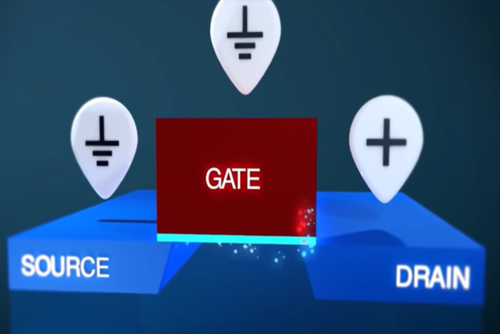
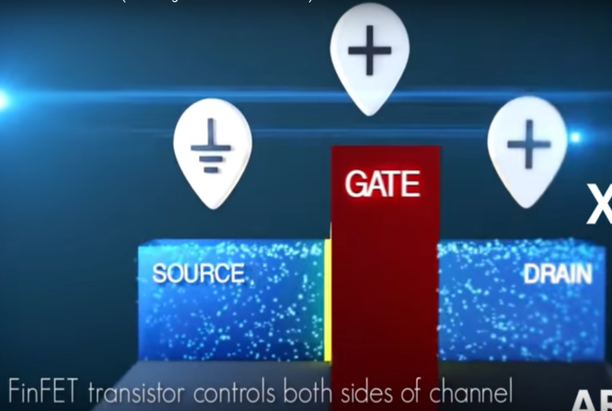
Which one is faster?
What is quantum tunneling?

Slide 12
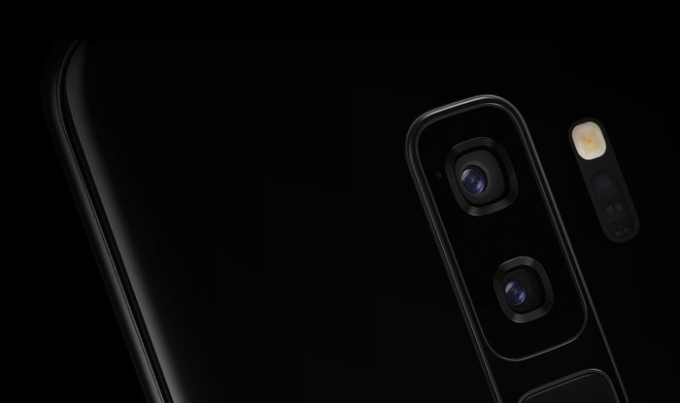
IMPROVEMENTS IN THE CAMERA FIELD
Bionic chips has two-parallel cores of the can handle up to 600 billion operations/second and can give effects even on live videos (apart from still pictures).
Bionic chip’s processor comes with an updated image signaling processor (ISP)and also includes Neural Engine to help process the image reference points.

Slide 13
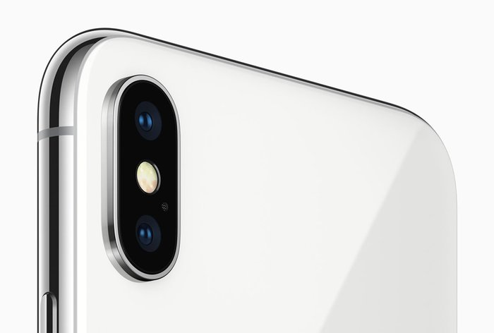
Moving on to the Qualcomm Snapdragon 845 camera improvements, it debuts with the Qualcomm Spectra 280 ISP. The Spectra 280 ISP will be responsible for improved color, pixel quality, and accuracy.
the Snapdragon 845 is the first chipset to support 4K HDR video capability.

Slide 14

ARTIFICIAL INTELLIGENCE
Bionic combines both neural networks and machine learning. This means that instead of explicitly programming the chip on how to perceive data, Machine Learning powers the device to read and learn from data.
Qualcomm isn't new to AI processing. The Snapdragon 845 is the third-generation mobile AI platform. The difference between the two chips lies in the fact how they are using the AI frameworks to get work done

Slide 15
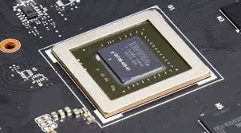
GPU- APPLE VS ANDROID
The Apple A13 Bionic graphics card is an integrated GPU in the A13 Bionic chip found in the iPhone 11 series. It includes 4 cores and offers a 20% better performance and 40% less power consumption compared to the A12 Bionic in the iPhone Xs series
Integrated graphics are more familiar to Android users because they are included on what we call a System-on-a-Chip (SoC) like the Snapdragon 810 which includes an integrated Adreno 430 GPU. This time, the memory used is the system memory and the GPU is integrated into the processor itself.

Slide 16
Price issue for apple and android:
Apple uses bionic chips which is usually more expensive than android chips(snapdragon chips).
Reason :bigger chips of apple.
But Apple develops Bionic chips for their own phones and hence the price is included in the device costs.

Slide 17


Slide 18
What exactly is bench mark?
We make benchmarking software for testing the performance of PCs, laptops, notebooks, tablets, and smartphones. A benchmark is simply a test that helps you compare similar products.
It helps you compare between products without you having to check each and every specification.
Higher the benchmark score better the performance.

Slide 19
Specifications | A-11 Bionic | Snap Dragon 845
Cores | 6 | 8
High Performance | 2 | 4
Energy Efficient | 4 | 4
Maximum Frequency | 2.45 GHz | 2.8 GHz
Geek Bench Score
Single core | 4228 | 2435
Multiple Core | 10265 | 8355

Slide 20
